Slide 1
CS 495 App Project
Lucius Guthrie
Mark Koren
Jesse Parker
Notes:
Possible names:
“At Ease”
Team presentation: 8-10 minute talk that summarizes your project (motivation, description, possible features, possible challenges)

Slide 2

Isn’t it frustrating?
Renting a place to live can be a lot of work, and when problems arise, communicating with your landlord can be a real hassle.
Whether it is paying rent or getting the landlord to fulfill maintenance requests, it always seems to take more effort than it should.

Slide 3
Common Rental Problems
No ease in paying for rent
Maintenance requests go unfixed
Poor Communication between tenants and landlords or property managers
Essentially, people should not have to constantly be worrying about their home

Slide 4

At Ease
Both landlords and tenants could benefit from an application that allows for better communication, maintenance tracking, and online rent pay.
The goal of “At Ease” is to keep both parties at ease, and clean up all of the worrying involved in the renting process.

Slide 5
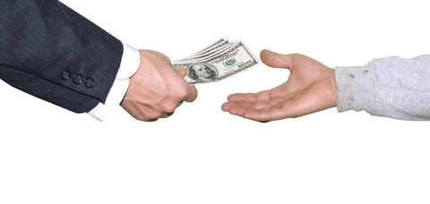
Rent Pay
Having to manually bring your rent check to your landlord is a bit outdated.
It is a hassle for the tenant having to go out of their way to mail or bring the check to the landlord.
It is a hassle for the landlord to keep up with their tenants’ checks if they have more than one tenant.

Slide 6

Solution
Tenants will be notified when a rent check is due, and will have the ability to pay the bill directly in the app.
The ability to pay instantly will help the tenant pay on time, and the ease of paying online makes it much more convenient.
Landlords will be notified when rent checks are paid and will be able to easily add late fees.
More convenient for landlords as well, as the rent is deposited into their bank account without any manual interaction.

Slide 7

Maintenance Requests
Maintenance Requests usually require some form of calling the landlord or apartment office and quickly detailing the issue that you are having.
The maintenance request process is mostly a manual process for both tenants and landlords.
Constantly calling for simple fixes feels like a waste of time.

Slide 8

Solution
Tenants will be able to easily submit maintenance requests from the app.
They will be able to check the status of their maintenance request.
Landlords will be able to automatically prioritize the maintenance requests.
They will also be able to update the maintenance status and comment on requests.

Slide 9

Communication
Most unpleasant issues faced by landlords and tenants spout from a lack of communication.
Ideally, tenants would keep the landlord informed of things that happen at the property.
For a landlord with multiple tenants, it can be a hassle to keep up with which tenant and which property needs something.
Notes:
#todo

Slide 10

Solution
Tenants will have an easy to use messaging system to directly contact their landlord.
Messages will be tied to your tenant account and rental property, will include all tenants at the property.
Landlords will be able to use the same messaging system to directly contact their tenants.
Helps landlords manage their tenants and properties.
Notes:
#todo

Slide 11

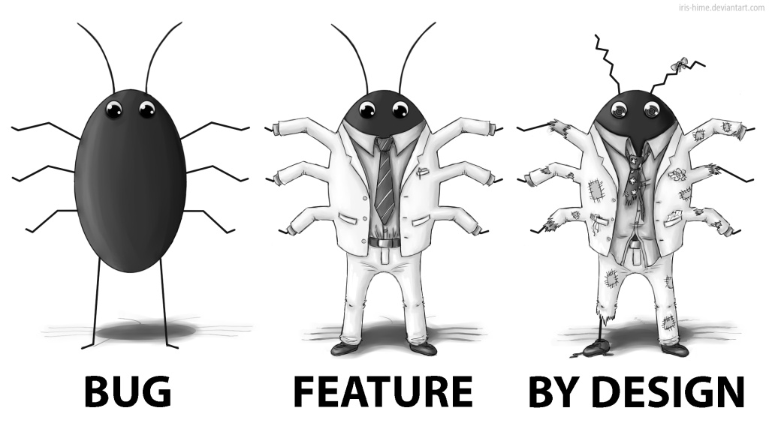
Possible Additional Features
Maintenance staff role
Lease terms and lease renewal
Ability for landlords to omit certain features they may not want to use
Review system for both tenant and landlord accounts
Complaint box
Notes:
#todo

Slide 12
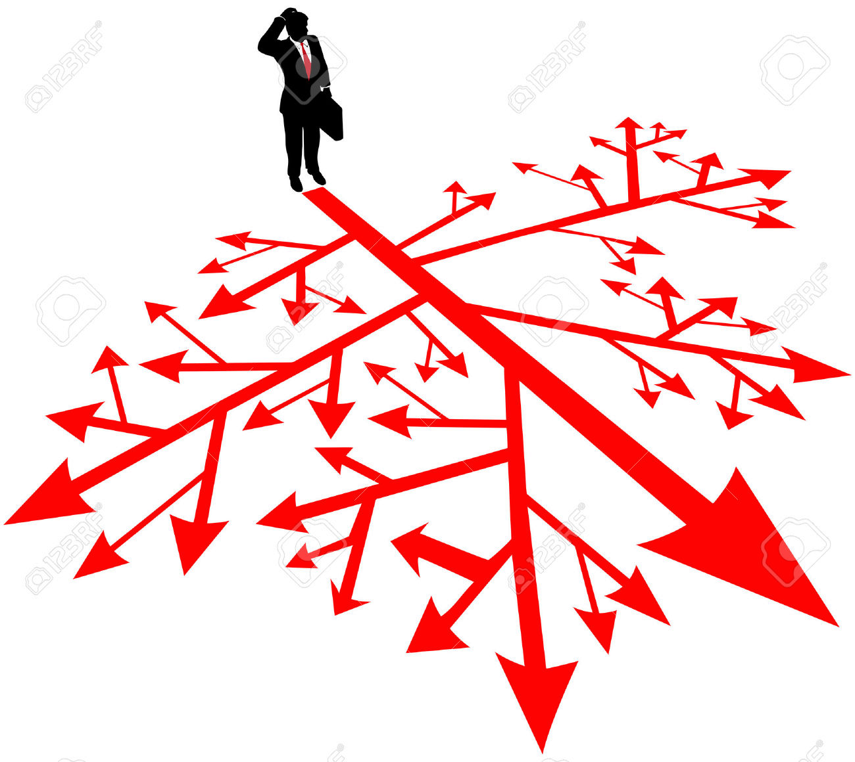
Challenges
Learning several different APIs
Setting up a backend
Securing user information
Handling payments
Designing a smooth user experience
Splitting up work effectively
Notes:
#todo

Slide 13
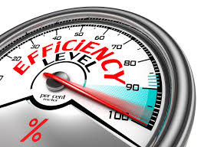
Conclusion
We believe our app with these particular features will help improve the efficiency of tenant to landlord relations and communication
Notes:
Maybe we don’t need this one?
otherwise, #todo

Slide 14
Fix to problem #1
Our app will feature different user profiles, including tenant and landlord or property manager
These profiles will be uniquely linked to each other based on tenant/landlord relations and will provide a smooth platform for communication between the two
This communication can be one on one, or users can enter chat forums where they can discuss issues and find solutions with other users
Notes:
Kinda added the third bullet just to give us stuff, y’all can tweak it if you can think of a better way to word it.

Slide 15
Fix to problem # 2
One of the key features of our app will be submitting and tracking maintenance requests
Why is this helpful?
For tenants: maintenance requests can sometimes go unnoticed, or take a long time to get done
For landlords: maintenance requests seem to pile on top of each other, and it’s tough to organize them, and make sure you’re providing the best service for your tenants
This feature would make the process of submitting, tracking, and following through with maintenance requests would benefit everyone in the equation, and make better overall relations between them.

Slide 16
Isn’t it frustrating?
We’ve all had bad experiences with trying to get something done by our landlord
We’ve all at some point forgotten (or have come very close) to pay month’s rent by the deadline
We’ve all had an emergency where we needed fast maintenance, but just couldn’t get in touch with the right person fast enough

Slide 17
The Solution
Our idea is the solution for any landlord and their tenants
We want to create an app with different interfaces and forums where tenants and landlords can communicate more efficiently about maintenance requests, bills, and things of the like

Slide 18
For the Independent
Catered more directly to IRO ( Independent Rental Owners)

